Slide 1
OR06-01-21
Developing a Reference Framework for Typical Development in the Young Pig Vinh Vu¹, Sharon Donovan²⁻³, Lauren Brink⁴, Qian Li⁴, Gabriele Gross⁴, Ryan Dilger^{1-2,5}, Stephen Fleming^{1,*}
Affiliations:
¹Traverse Science, Champaign, Illinois, USA
²Division of Nutritional Science, University of Illinois, Urbana, Illinois, USA
³Department of Food Science and Human Nutrition, University of Illinois, Urbana, IL, USA
⁴Reckitt Mead Johnson Nutrition, Evansville, Indiana, USA
⁵Piglet Nutrition and Cognition Laboratory, Department of Animal Sciences, University of Illinois, Urbana, IL, USA
Notes:
Hi my name is Vinh and thank you for stopping by this talk! Today I will present to you a project that I have had a great opportunity to take part of which is Developing a reference framework for typical development in the Young pig.
This work was done in collaboration between Traverse Science where Iam from,

Slide 2
Disclosures
AFFILIATION/FINANCIAL INTERESTS (prior 12 months) | ENTITIES
Grants/Research Support | Reckitt Mead Johnson Nutrition, Nestlé Nutrition, California Walnut Commission, BASF, Beachbody, Bush Brothers
Scientific Advisory Board/Consultant/Board of Directors | None to disclose
Speakers Bureau | None to disclose
Stock Shareholder | None to disclose
Employee | Traverse Science
Other | None to disclose
Notes:
Here we want to disclose our funding, which are the entities listed here

Slide 3
How can safety assessments of
new ingredients in infant formula be improved?
When are deviations from “typical” of concern?
Notes:
Beginning with the motivation of this project we wanted to ask how can safety assessments of new ingredient in infant formula be improved?
And also when are deviations from typical a concern

Slide 4

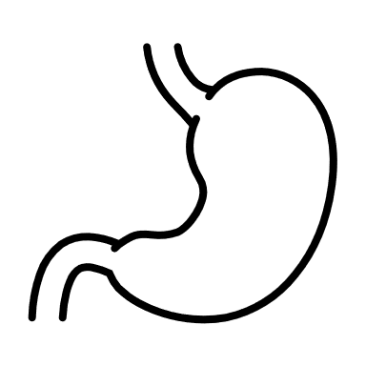







Preclinical Testing of Ingredients in Infant Formula
Conduct Preclinical Study
Choice of Preclinical Model
Evidence of abnormalities based on external data?
Rodents
Pre-weaning feeding is difficult
Pigs
Highly translatable¹
No
Yes
Adverse effect
Level 1 Assessment
(standard measures)
Level 2 Assessment
(detailed study)
No
adverse effects
No
adverse effects
Adverse effects
≈
Continue to clinical studies
Re-evaluate results before clinical trial
STOP
Adapted from “Infant Formula: Evaluating the Safety of New Infant Formula Ingredients”
2004, Institute of Medicine.
¹Odle et al., 2014. Annual Review of Animal Biosciences. 2014;2(1):419-444.
Notes:
Rodents
Pre-weaning feeding is difficult
Both oral gavage and individual rearing induce significant stress effects
Pigs
The National Academy of Medicine recommends nonhuman primates and young pigs as alternative developmental models to rodents given the difficulty of feeding preweaning rodents
These models have similar gastrointestinal and neurodevelopmental patterns, improving their translational value
---------------------------------------
Level one are organ weights
A key benefit is also the immune development, whichis much closer - 80% homologous in to man for pig, vs. 10% for rodents
-------------------------
The national academy of medicine provided this guideline on considerations to make when testing for safety and quality of ingredients in infant formula.
So if we take a look at this flow chart on the left here it starts out with conducting a preclinical study in which if there isn’t any evidence of abnormalities from external data that are found we can proceed to lebel 1 aseesments which are assessment looking at organ weights, if no adverse effects are found we can continue to clinical studies. If there are adverse effect either based on the level 1 assessment or from external ecidence a level 2 assessment then needs to be carried out, which usually involve immunohistochemistry and cell-culture work.
The IOM also recommends non human primates and young pigs as alternative developmental models to rodent given pre weaning feeding is difficult. Thus using the pig as a model here is highly translatable to humans

Slide 5
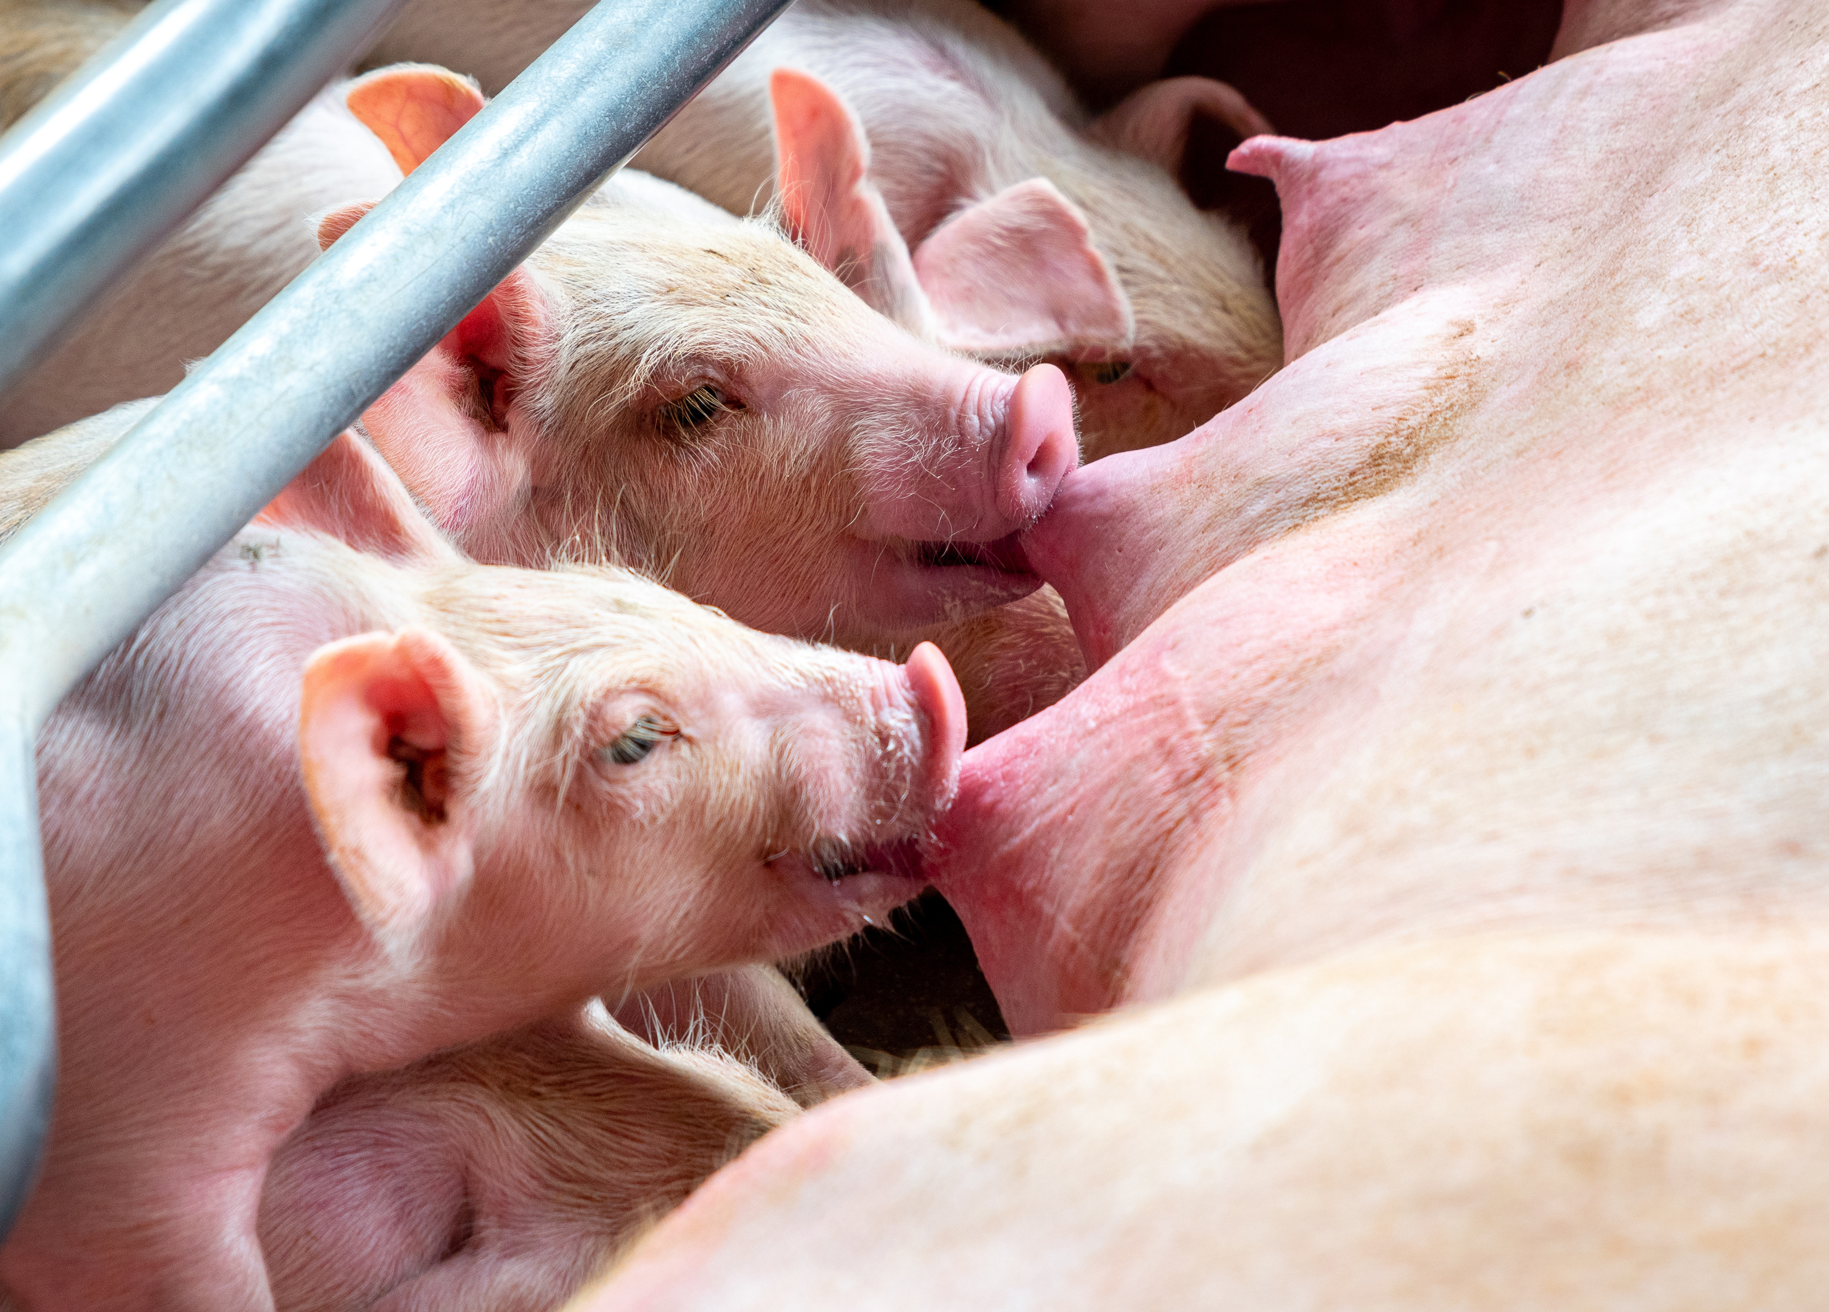
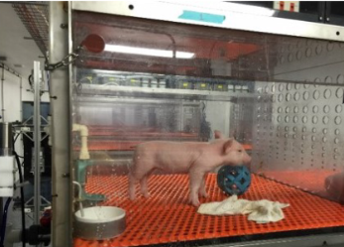
Modelling Breastfeeding in a Preclinical Setting
Pro
Artificially-reared
Sow-reared
Maternal and littermate interaction
Consume porcine milk
Complete nutritional control
↑ Human interaction
Easier to conduct behavioral trials
Competition for nutrition
Can’t control milk composition
Can’t control intake
Difficult to conduct behavioral trials
Absence of maternal rearing
Fewer littermate interactions
Do not consume porcine milk
Con
New ingredients can’t be tested
in sow-reared models
Notes:
While pigs are a great model for translational research, we should appreciate the differences between their rearing environment, that is between sow-reared and artificially reared pigs.
Lets take a look at the pros and cons for each. Sow reared are raised with maternal care and thus consume porcine milk and have littermate interaction.
As for cons, there can be competition for nutrition, and because they consume porcine milk we cant control the milk composition or the intake. They are also difficult to conduct behavioral trials on
Pros for artificially reared pigs include the ability to have complete nutritional control, human interaction and are easier to conduct behavioral trials on. Cons for this group includes that absence in maternal care and rearing, and because of that they also do not consume porcine milk. They also have fewer littermate interactions
The important thing to note here is that NEW ingredients cant be tested in sow-reared models, so theres a lot of reliance on artificially reared pigs to test those. The good thing is that a recent study by the dilger lab at UIUC found that growth has been shown to be equivalent between artificially reared and sow reared pigs.

Slide 6
What is “Typical”?
Clinical trial
Preclinical trial
Breastfed (reference)
Species-milk (reference)
?
?
?
Formula 1
Formula 1
Which of these is averages is “typical”?
Formula 2
Formula 2
Response Variable
Response Variable
Response Variable = body/organ weight, histology, immune response, hormones, etc.
Notes:
In clinical trials, investigations into novel formula rely on reference or standardized growth charts in order to assess growth and tolerance, as shown in this char to the left here.
However, reference ranges are currently not available for young pigs, which leads to the problem, what do you compare it to when your performing a preclinical assessment? We don’t really know whether formula 1 or formula 2 of whatever response variable is comparable to the typical range.
And if we can’t compare it to a typical range, we do not know they are safe

Slide 7
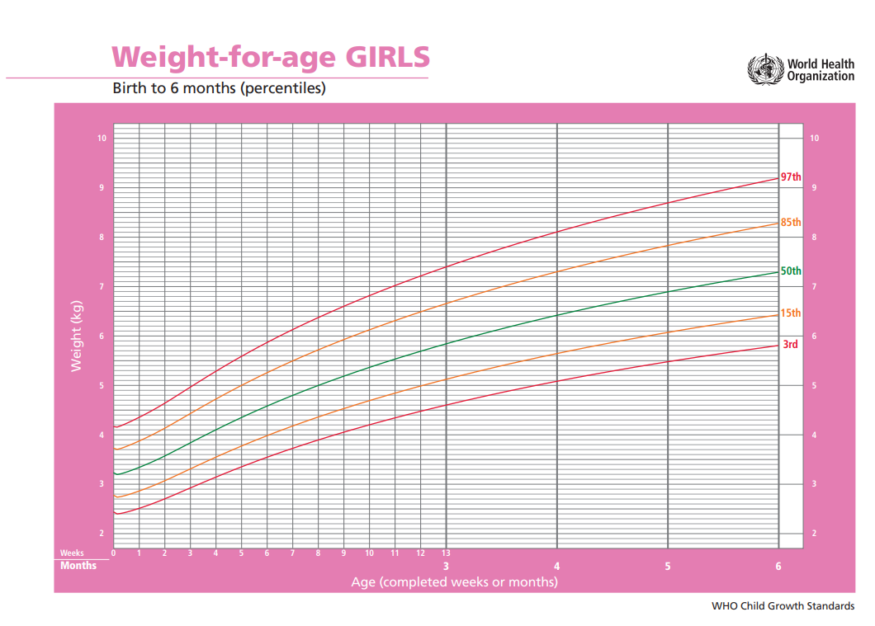
The Limiting Factor: Reference Data
Problem
There are few “X-for-age charts” in preclinical research
X = bodyweight, hormones, cytokines, histology, etc.
Are internal controls adequate? How can we differentiate between statistical and biological significance?
Solution
Development of inter-institutional references to classify typical development
https://www.who.int/tools/child-growth-standards/standards/weight-for-age
Notes:
So if the problem is this limiting factor of reference data, where there are a few X-for-age-charts, which makes you question whether internal controls are adequate, and whether we can differentiate between statistical and biological significance.
In this project we propose a solution in the development of a collaborative in nature reference chart to classify typical development of Young pigs for use in the safety and efficacy of infant formula.
Similar to the growth percentile chart for boys and girls put out by the world health organization

Slide 8
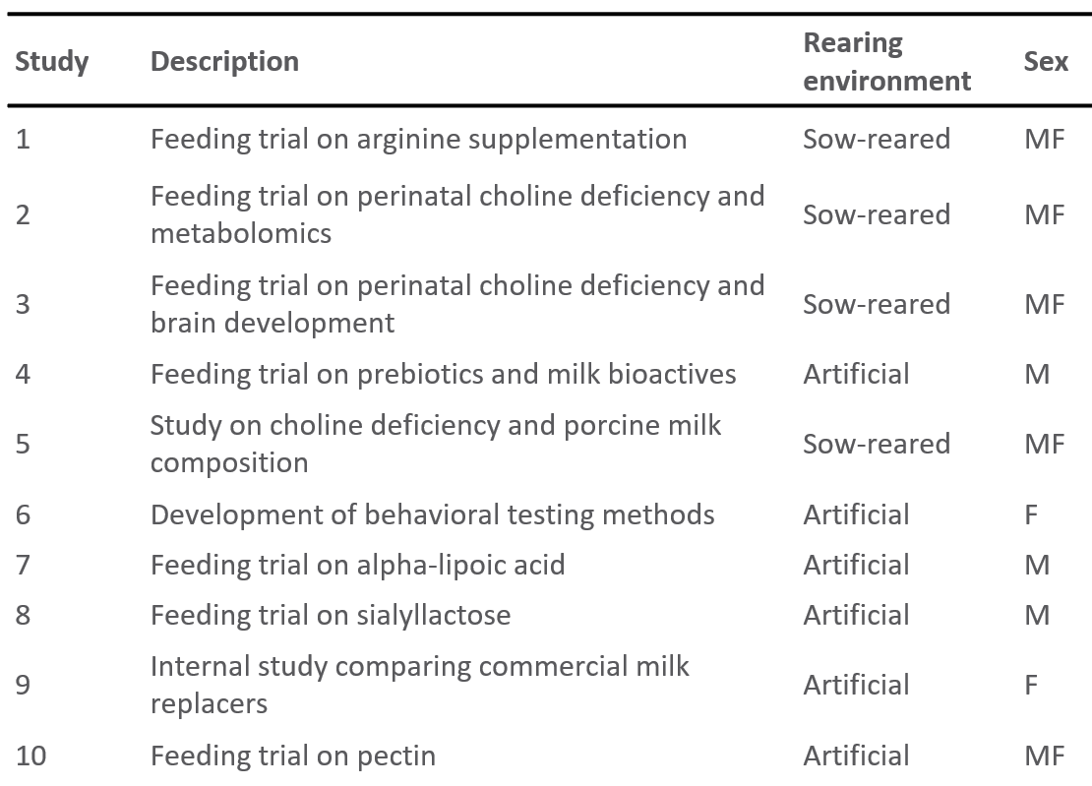





Conclusion
Data Sets Reviewed
Process
Import
Tidy
Transform
Visualize
Model
Communicate
Notes:
The data sets that were analyzed comes from 22 studies which spans over a decade of research in young pigs, we had over 18,000 data points from 786 animals. Represented in this table here are just 10 of the studies and two of the many many metadata that was collected.
The process for this analyses follows like so: we import all data, Use R-programming language to tidy the datasets into a format that is analyzable. We then do a loop of transformation, visualization and modeling of the data until the best statistical model was found to represent the data, in this case it was a non linear mixed effect model.

Slide 9
Data Included
Body Weights
Organ Weights
All pigs
n = 786
“Failure to thrive”
n = 24
“Experimental”
n = 373
Experimental
n = 137
Brain n = 43
Intestine n = 20
Liver n = 42
Heart = 8
Kidney = 8
Lung = 8
Spleen = 8
“Control”
n = 389
Reference Group
n = 158
Brain n= 28
Intestine n = 76
Liver n = 16
Heart = 8
Kidney = 8
Lung = 8
Spleen = 14
Sex
Rearing Environment
Feeding Regimen
Male
n= 242
Artificial
n = 201
Ad libitum
n = 53
Female
n = 147
Sow
n = 188
Prescribed
n = 148
Artificially Reared
Reference Group
Notes:
Here is a schematic that shows the inclusion and exclusion process and the total number in each group. In total, we have data collected from 786 pigs .the control groups which are animals from the 22 studies that were fed control diets and the experimental group includes pigs that were fed with intervention diets. Control pigs are further broken down into their sex rearing environment and feed regimen. Organ weights were also collected and are shown here, in total we have about 137 in the experimental group and 158 om the reference group.

Slide 10
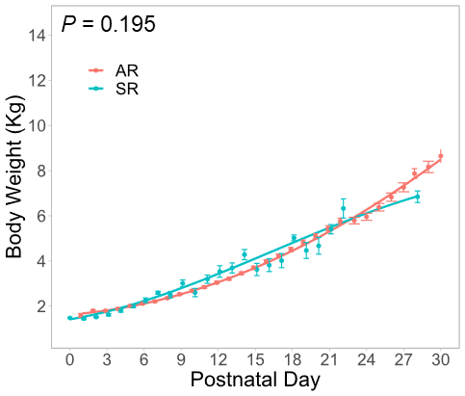
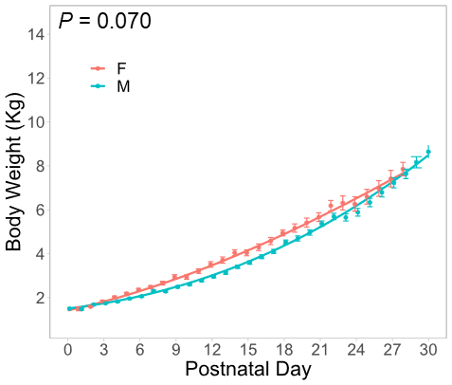
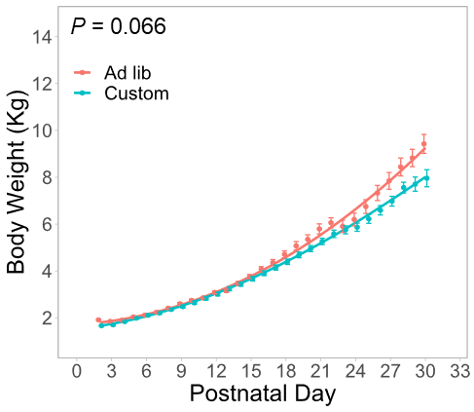
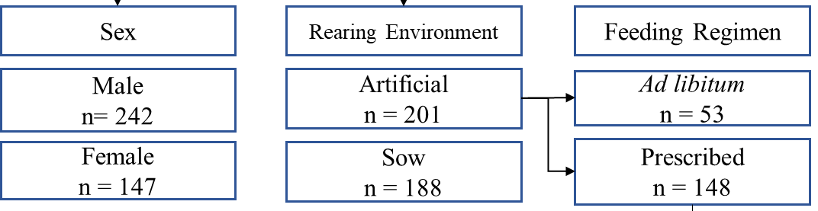
Rearing Environment, Sex, and Feeding Regimen Minimally Affect Growth Rate of Young Pigs
Rearing Environment
Sex
Feeding Regimen
Prescribed
Notes:
In these plots body weight is plotted as a function of the first 30 post natal days for rearing environment, sex, and feeding regiment. All in all, despite different trajectories between groups there were minimal differences in main effects of rearing vinronment, sex or feeding regiment. With pvalues greater than 0.05
Since there weren’t any difference between the rearing environment in terms of growth, the reference growth chart in the next slide was created from the artificially reared group that were fed a prescribed diet. Which includes 148 animals in that group.

Slide 11
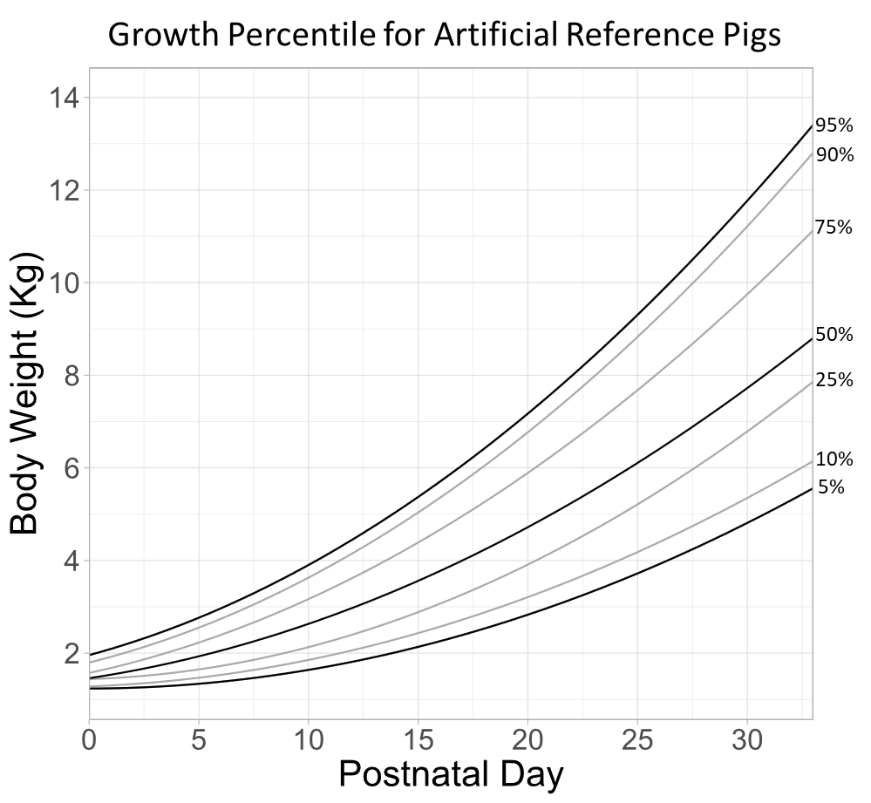
Growth Percentile Plots Depicting Typical Growth
Reference charts provide context
Was growth within an expected range?
If growth was inhibited, to what extent?
Iron deficient vs. failure to thrive
An assessment of how safe an ingredient is
Body weight is a first step, can the same be done for other data?
n= 148
Notes:
We constructed the reference growth chart in the style of the world health organization growth chart for boys and girls following similar quantiles 5,10,25,50,75and 95%.
This reference chart can be use to determine whether growth was within an expected range for different interventions.

Slide 12
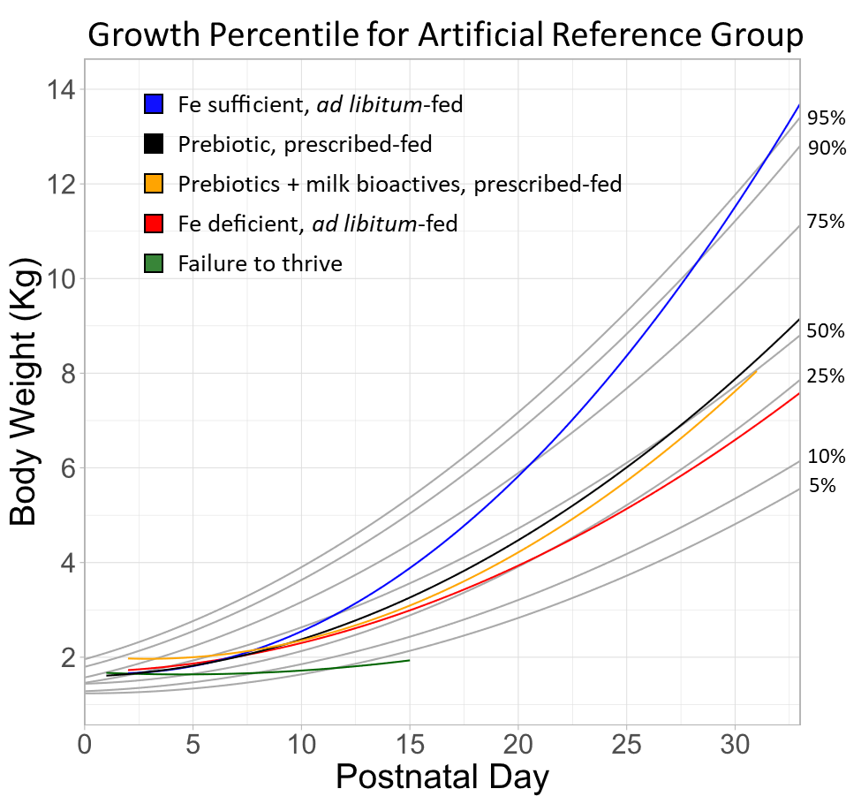
Growth Percentile Plots Depicting Typical Growth
Reference charts provide context
Was growth within an expected range?
If growth was inhibited, to what extent?
Iron deficient vs. failure to thrive
An assessment of how safe an ingredient is
Body weight is a first step, can the same be done for other data?
n= 148
Notes:
Here we overlay several examples to illustrate how this chart can be used. We see that pigs that were prescribed-fed with either prebiotic alone or prebiotics with milk bioactives in black and yellow grewed normally, hovering directly over that 50% quantile/
Where as adlibitum fed iron deficient pigs in the red here grew more poorly at around 25% quantile. The failure to thrive group here represents pigs that for whatever reasons just did not grew well or became sick, and so it became pretty clear to us that these terminally poor growth pigs may be identifiable within he first 10 days.
This group really served as a good metric to interpret severity of inhibited growth.
And on the polar opposite, some group grew exceptionally well, the iron sufficient group which was an internal control for the iron deficient group grewed past the 95% quantiles by PND 30, however a good thing to note here is that unlike other groups, these pigs were fed adlibitum. And if you remember from our previous plot, the ad lib fed pigs and prescribed fed pigs were similar until around day 15 where adlib pigs started to grow more quickly. Therefore this example here can represent an atypical case of accelerated growth.
So now we have looked at body weight data and made a reference chart out of it that can be used to identify typical growth, but can it be done for others?

Slide 13
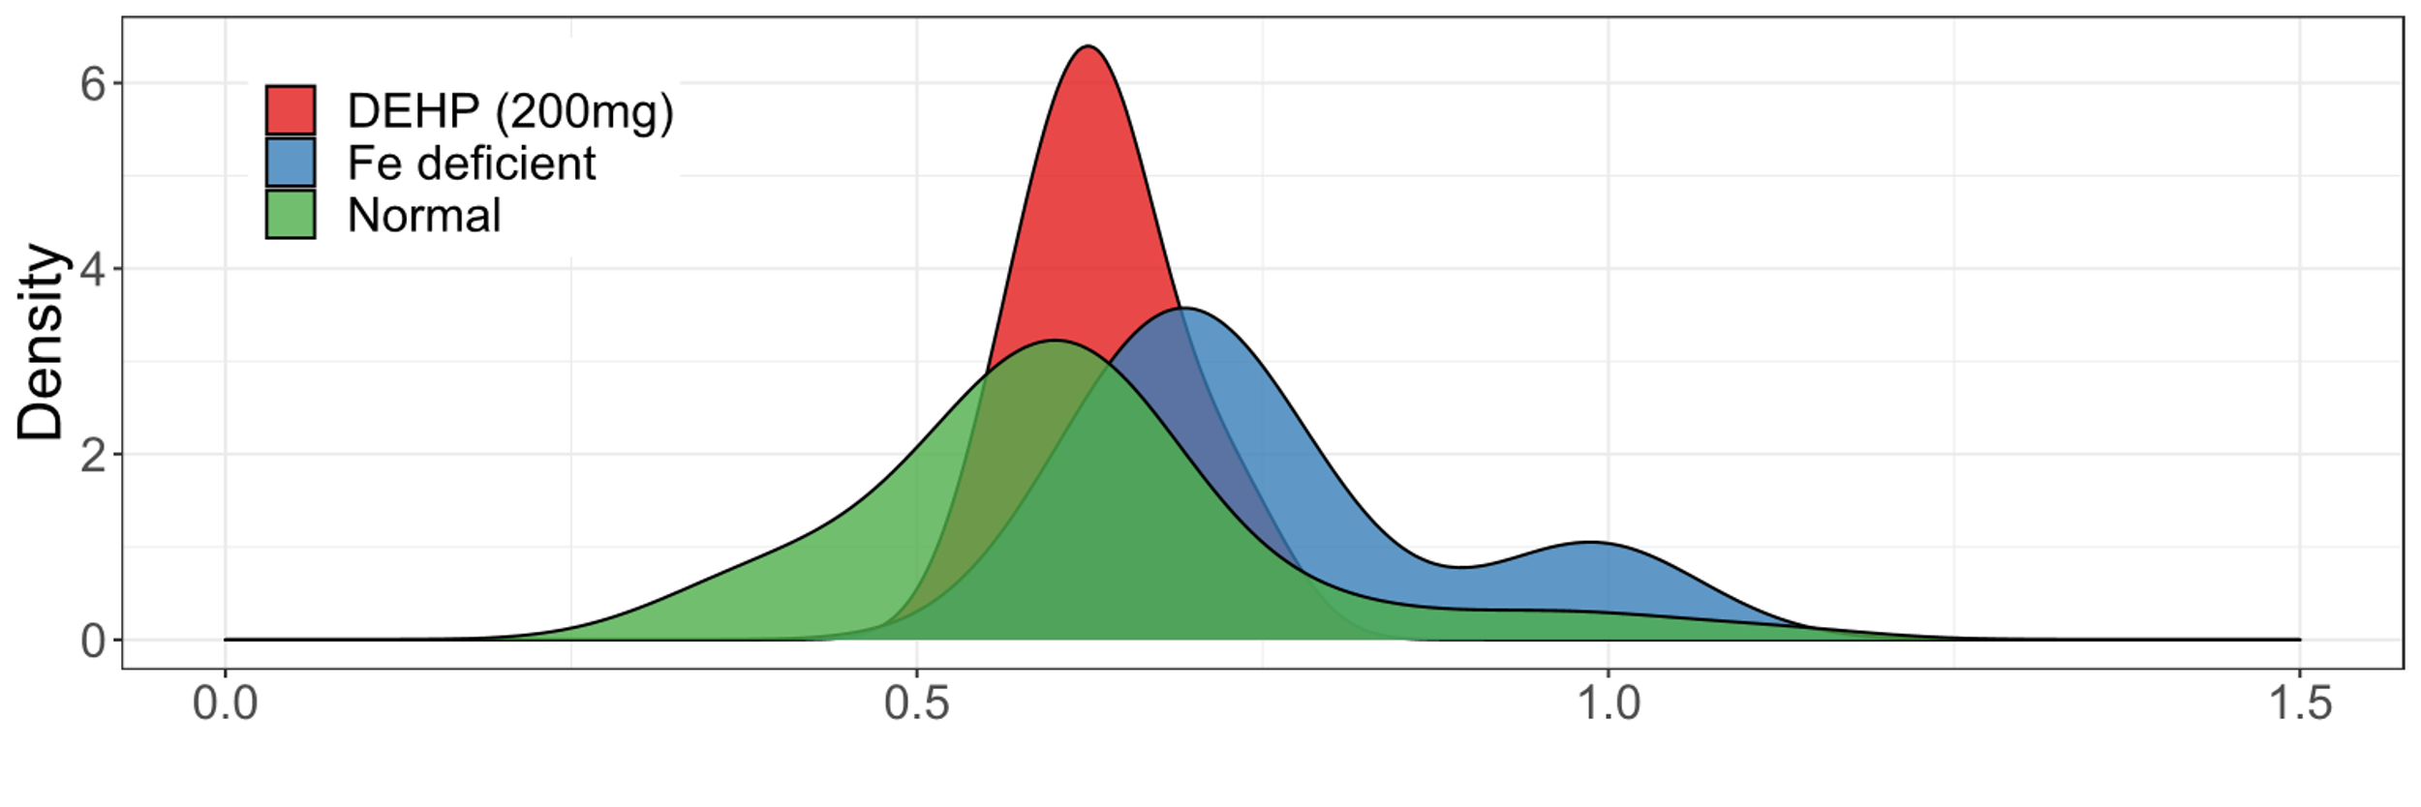
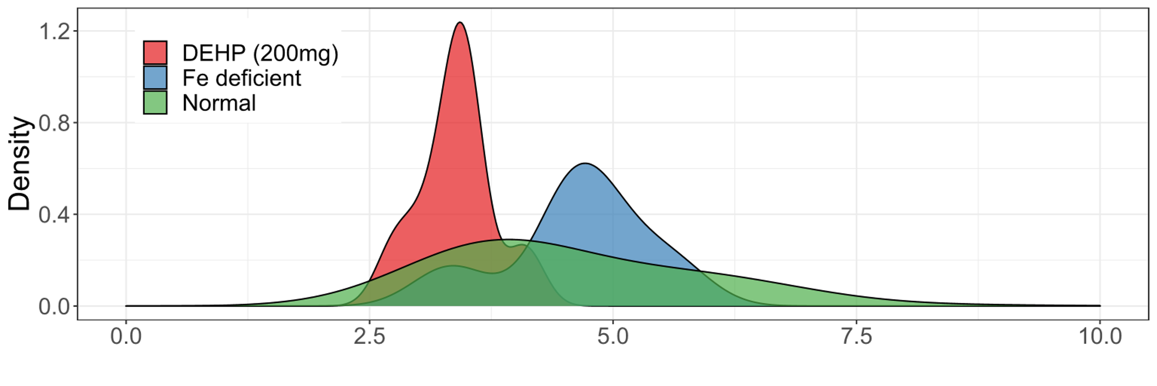
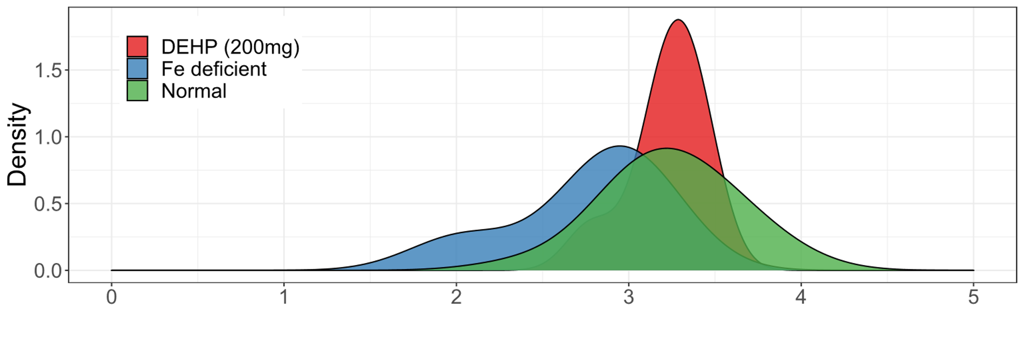
Distribution of organ weights alone is not sufficient to determine safety
Phthalate exposure
Similar
to
reference
Reference
Phthalate exposure and iron deficiency are known disruptors of organ development
Comparing distributions alone, relative brain and liver weights appear fairly normal compared to the reference group
Brain (% BW)
Brain (% BW)
Phthalate exposure
Reference
Intestine (% BW)
Phthalate exposure
Similar
to
reference
Reference
Can existing data be used to paint a richer picture?
Liver (% BW)
Notes:
Lets take a look at our organ weights, plotted here are density plots of relative brain, intestine and liver weight. And its relative because we’re looking at the organ weight as a percent of total body weight to control for differences in weight.
If your enot familiar with density plots they just shows the smoothed distribution of the points along the x-axis. The peaks of the density plot are at the locations where there is the highest concentration of points
We see that for cases of brain and liver that if we look at distributions alone, phthalate exposure and iron deficiency which are know disruptors or organ development are similar to the reference distribution.
This lead us to ask is this an appropriate way to look at this data? And Can existing data be used to further paint a richer picture?

Slide 14
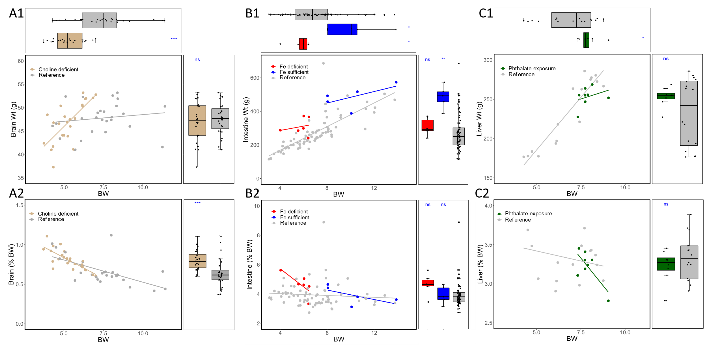
Enhancing the Value of Organ Weights for Safety Assessments
Notes:
There’s a lot to unpack on this slide but lets focus on the left most A1 and A2 panel here.
In A1 we have the absolute brain weight and in A2 we have the relative brain weight that you’ve seen before. So here what we have done is plot the brain wt and regress that against the BW, in addition we also provide marginal boxplots to represent the data of each axis.
Focusing on A1 we can see that on our right box plot showing no difference in brain weight for choline deficient and reference pigs, however for our relative scenario we see there is a difference. But these body weight for the choline deficient group are also much smaller which is shown in our top boxplot so the relative change is more reflective of the change in body weight rather that brain growth.
Looking at the two slopes however, we can see that both slopes are pretty similar for the relative brain weight in A2, however the slope for choline deficient in the absolute brain weight is much more steep. This tells us that during choline deficiency, pigs that have higher body weight also have higher brain weight.
In the middle panel here we’re looking at the same type of plots but for intestines. You can here that iron deficient animals intestinal weights are similar to reference on both abs and relative scale. And as we’ve seen before in the density plots the iron sufficient group that was used as an intertal control showed a much higher weight that reference group. And if we look at their slopes of the absolute intestine weight we see they follow a similar relationship, but when we switch to a relative scale, we notice that the fe deficient group is mich different, where aniomals with larger BW showed lower intestinal weight, this indicates that the accumulation of intestinal mass lagged behind the total body mass greatly is iron deficient animals.
Lastly, our panel on the right compares Phthalate exposure to the reference group and we’re looking at liver weight here. Like intestinal weight if we look at liver weight alone, there is no significant difference on both an abs and relative scale, but its when we compare the slopes that they reveal another story. On either abs or relative scale the regression of liver wt to BW for phthalate exposure differs greatly from the reference group, and this is quite stunning on the relative scale here where ,the liver weight decreased with body weight more rapidly than reference group.
This is a more substantial example from where if we just look from avs and realiver weight alone, high exposure of phthalate might be considered safe, despite published reports that it can perturb liver metabolisms in rodent.
This gets us to our punchline that looking at organ weight distribution alone isn’t enough, we need to look at these data on a bivariate level to better enhance our understanding of what is safe.

Slide 15

Limitations of the Data
Given various projects spanning a decade of research, this database was imbalanced.
These factors have minimal effect on the interpretation of data within a study as all subjects were treated similarly
The data reported were chosen as they were all from studies conducted by and owned by the authors, who had access to the raw data
Notes:
To wrap up, I want to quickly go over some limitation of this project.
Given the dynamic nature of scientific objectives over a decade, this database was highly imbalanced with respect to the study designs, sampling frequencies, and sample sizes between studies
These factors, however, may have minimal effect on the interpretation of data within a study as all subjects were treated similarly
The data reported were chosen as they were all from studies conducted by and owned by the authors, who had access to the raw data

Slide 16

Future Opportunities
This database is a first step towards organizing research from multiple institutions, which will allow far greater power to understand biological development.
For safety and efficacy assessments of infant formula, it will provide needed background for assessing the relative risk-to-benefit ratio for novel ingredients.
Notes:
And lastly the liminations listed before really present us with future opportunities, opportunities to have a dynamic and collaborative database.
And so this database

